Slide 1

NJ-1040 Overview
NJ 1040 for Familiarization

Slide 2
NJ 1040 Paper Page 1
Page I of the NJ 1040Tax Form includes:
  Taxpayer personal information
  County/Municipality Code
  NJ Filing Status
  Exemptions
  Dependent information
  Gubernatorial Election Fund Check Boxes
  Signature Box

Slide 3
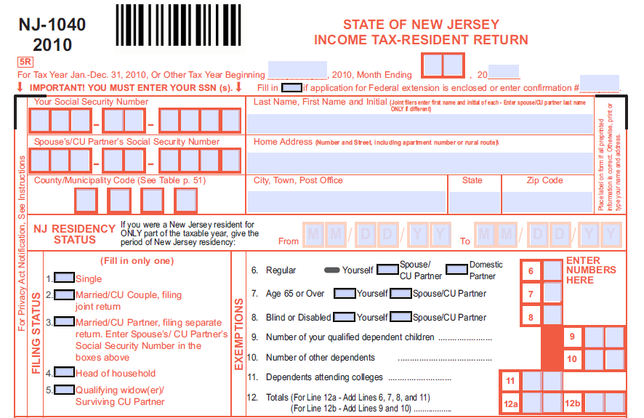
NJ 1040 Page 1

Slide 4
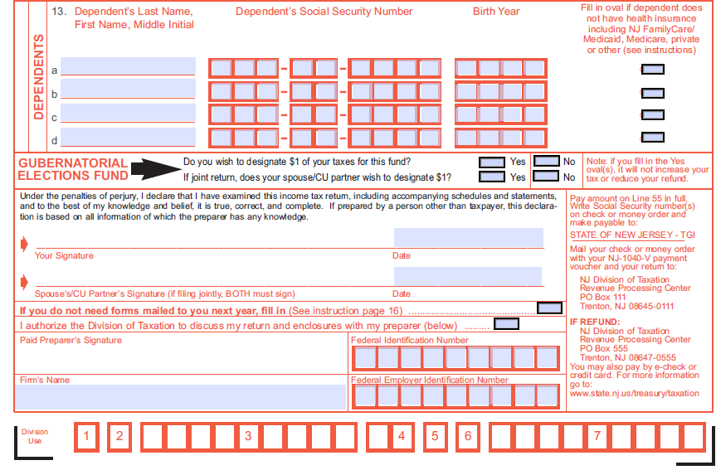
NJ 1040 Page 1

Slide 5
NJ-1040 Page 1

Slide 6
NJ 1040 Paper Page 2
Page 2 of the NJ Tax Form includes
  Income
  Exclusions
  Exemptions
  Deductions
  NJ Taxable income
  NJ Tax

Slide 7
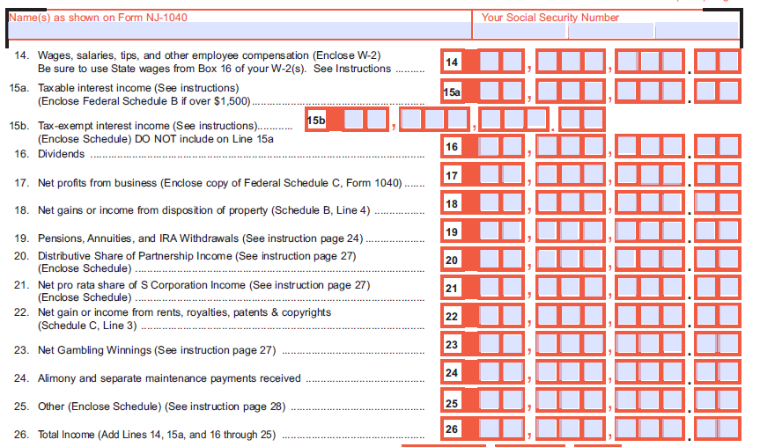
NJ 1040 Page 2

Slide 8
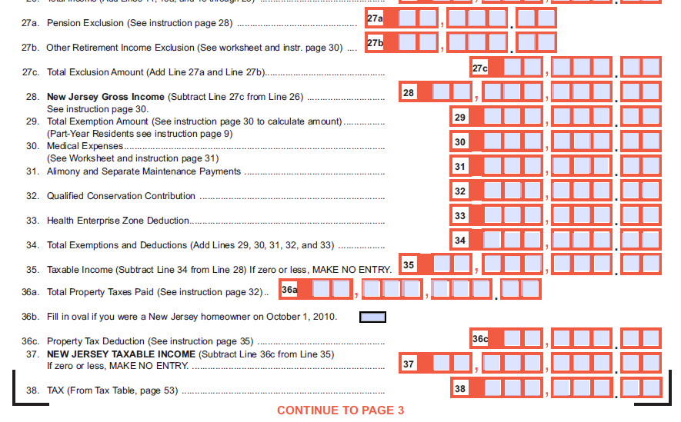
NJ 1040 Page 2

Slide 9
NJ-1040
Page 2 (Printed) / Page 3 (E-file)

Slide 10
NJ 1040 Paper Page 3
Page 3 of the NJ Tax Form includes
  Credits
  Use tax on out of state purchases
  Penalties
  Amount owed
  Amount to be refunded

Slide 11
NJ-1040
Page 3 (Printed) / Page 4 (E-file)

Slide 12
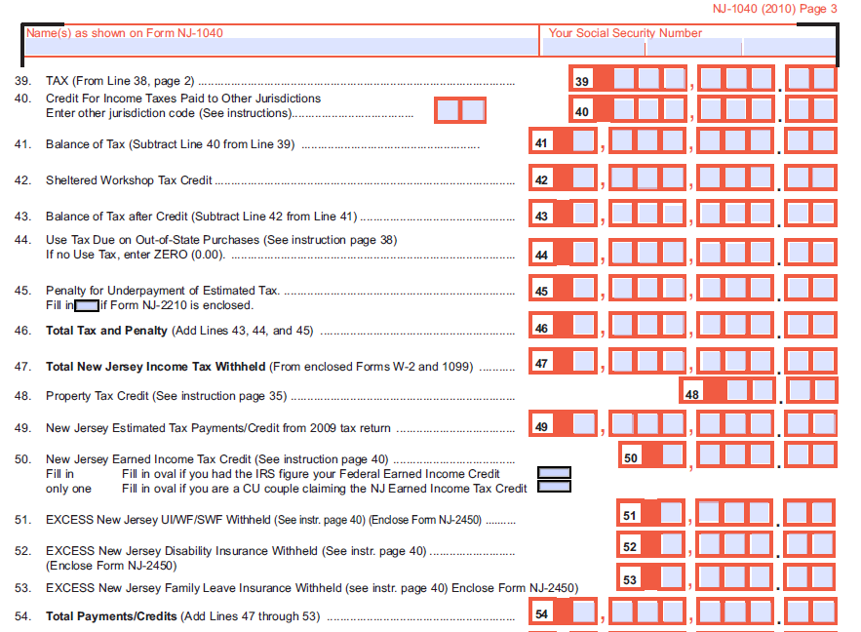
NJ 1040 Page 3

Slide 13
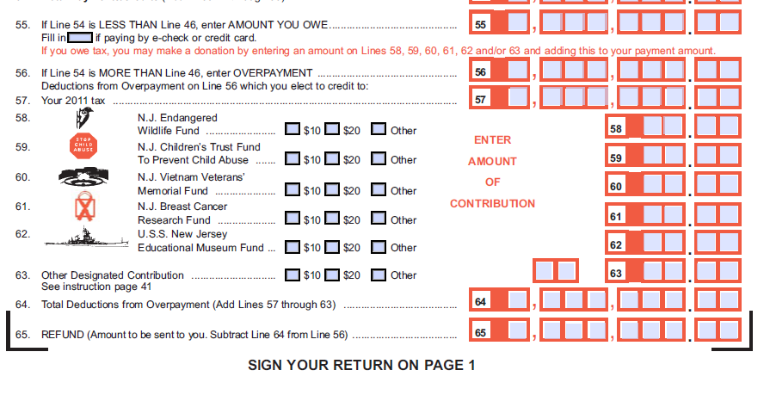
NJ 1040 Page 3

Slide 14
TaxWise NJ 1040
Most of the information is carried forward from the TaxWise Federal 1040 to the TaxWise NJ 1040
Page numbers in TaxWise do not match page numbers of the paper return
NJ 1040 entries can be tricky

Slide 15
TaxWise NJ 1040 Entries
The following items are the minimum required manually input entries:
  County/Municipality Code must be entered in the TaxWise NJ 1040 on page 1
  Gubernatorial Election Fund Question must be answered in the TaxWise NJ 1040 on page 3
  Homeowner on Oct 1 question must be answered on the TaxWise NJ 1040 on page 3
  Use tax due on out of state purchases must be entered in TaxWise NJ 1040 on page3
  Worksheet F Property Tax Deduction/Credit in the TaxWise NJ 1040 on page 4
  NJ DD Worksheet
  NJ IRA Worksheet (Taxpayers with IRA withdrawals)

Slide 16
Worksheet F
Taxpayer is entitled to a property tax deduction or $50 property tax credit
Worksheet F does the calculation to determine if the deduction or credit is more beneficial
On line 1 enter rent paid or property tax paid for tax year
TaxWise chooses tax deduction or tax credit & puts the amount on the proper line

Slide 17
NJ 1040 for Familiarization
New Jersey entries can be tricky
For Familiarization we are doing basic
More detail on NJ coming later

